Slide 1

What Do People Think Of Robots In Different Cultures?
汇报人：Group 2 –G2
谢皓原 郭宇航 李磊 贾振强 肖滟兰

Slide 2
0 1
Introduction
CONTENT
0 2
Different Cultural Attitudes
0 3
Different Social Acceptance
0 4
Conclusion

Slide 3

PART 1
Introduction of team members and research

Slide 4



Team members
01
leader
贾振强
02
timekeeper
郭宇航
03
李 磊
Secretary
04
encourager
肖滟兰
05
谢皓原
Harmonizer

Slide 5
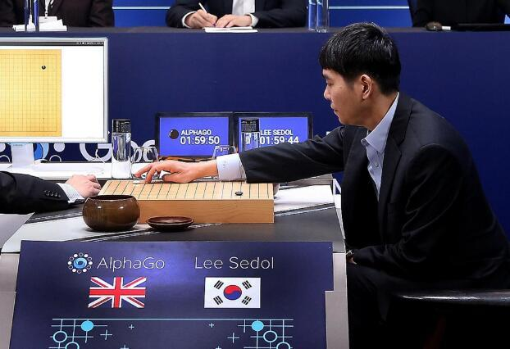
Introduction
The total score is 4:1! Alphago finally beat Li Shishi

Slide 6
Introduction
A study of robots’
social acceptance
Different cultural attitudes
Conclusion
Differences on social acceptance

Slide 7
PART 2
Different Cultural Attitudes

Slide 8
The East VS The West
Questionnaire survey done by Professor Nomura in 2016.
Sample Number = 400.
Emotional attitudes towards robots’ culture.
East
West
55%
41%
37%
24%
22%
21%
For
Neutral
Against
For
Neutral
Against

Slide 9


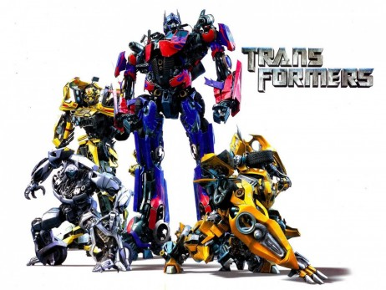
Different Cultural Attitudes
Will robots take over the world?

Slide 10


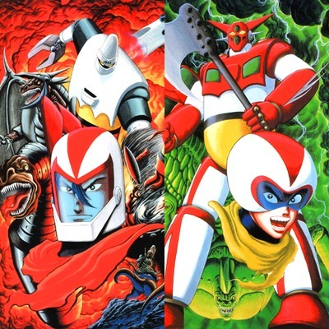
Japanese Robots’ culture
Interact with robots more smoothly.
Relate humanoid robots with social activities.
Focus on the impacts robots might have on society.
Superheroes!
Clever
Brave
Righteous
Friendly

Slide 11
PART 3-1
Differences on Social Acceptance

Slide 12
Different Social Acceptance
Differences
West
East
solve social problems
help the old
household tasks
social well-being issues
industrial production

Slide 13
Different Social Acceptance
Analysis
West
East
Development
&
Popularization of Robots
Economy
High COST

Slide 14
PART 3-2
A Study of Robots’ Social Acceptance

Slide 15

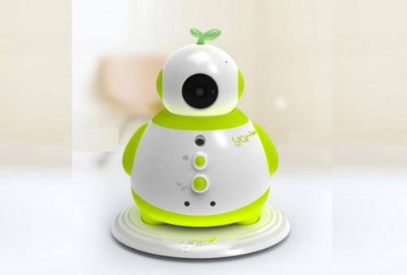
A study of robots’ social acceptance
Disability Therapy
Child Caring

Slide 16

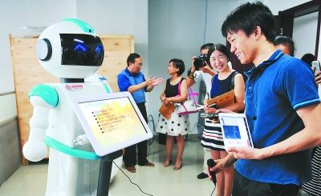
A study of robots’ social acceptance
QUESTIONNAIRE
INTERACTION WITH ROBOTS
Experiment

Slide 17
A study of robots’ social acceptance
Conclusion
West
East
extroverted tendency
understanding
extroverted tendency
understanding
Humanity choose to
stay its independency
The unity of man and nature

Slide 18
PART 4
Conclusion

Slide 19
Conclusion
Cultural attitudes
Social acceptance

Slide 20
Conclusion
Cultural attitudes
Western people have more ideas and understandings towards robots
Japan, to be the No.1 to adapt to interact with robots

Slide 21
Conclusion
Social acceptance
East
West
Cares:
Industrial production
Solving their own affairs
Cultural background influences social acceptance to robots
Easterners keep more tolerance for technology

Slide 22
Thanks for listening

